Slide 1
Shooting game: Space Wars
Media art 206 midterm presentation
Zixu Geng
zg73

Slide 2
01. Inspiration
Index
02. Implementation
03. Interactive

Slide 3
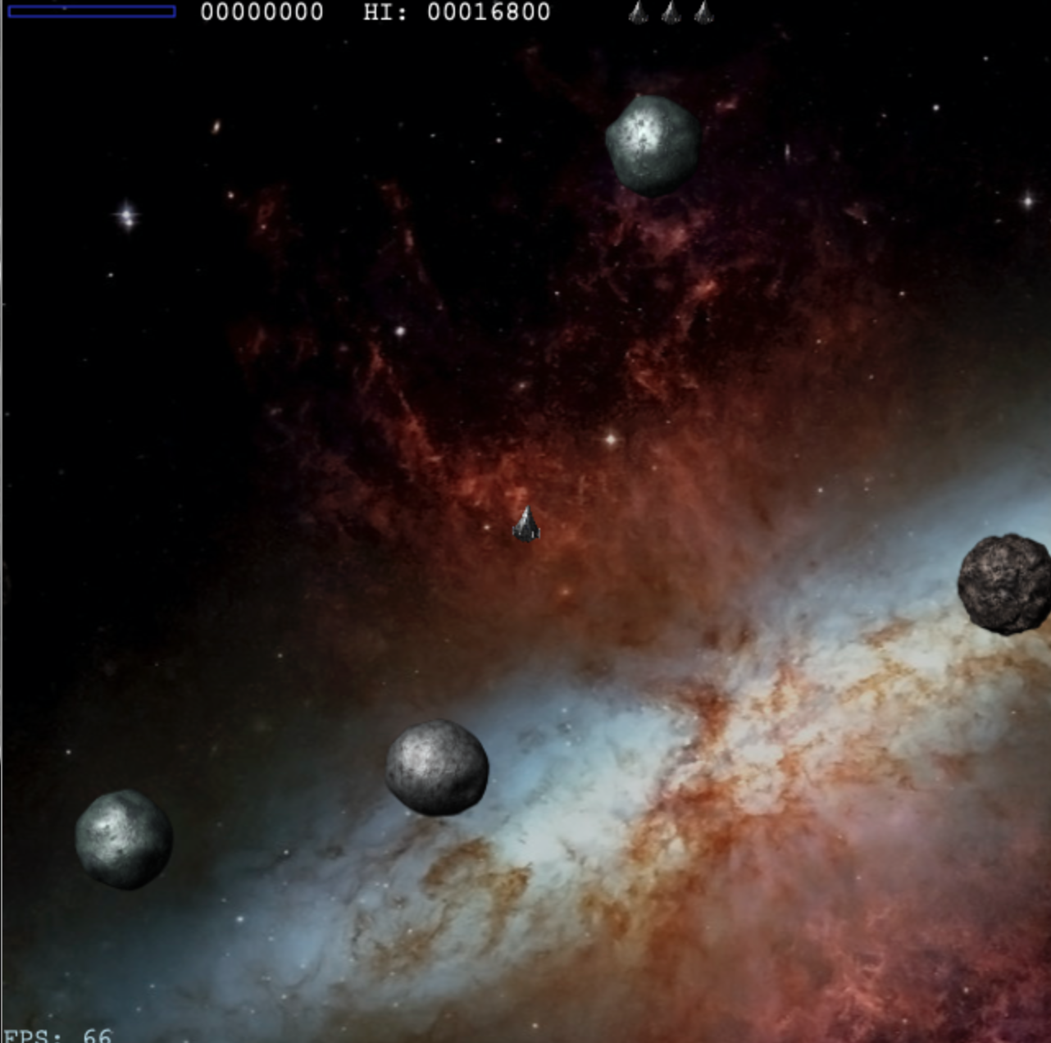
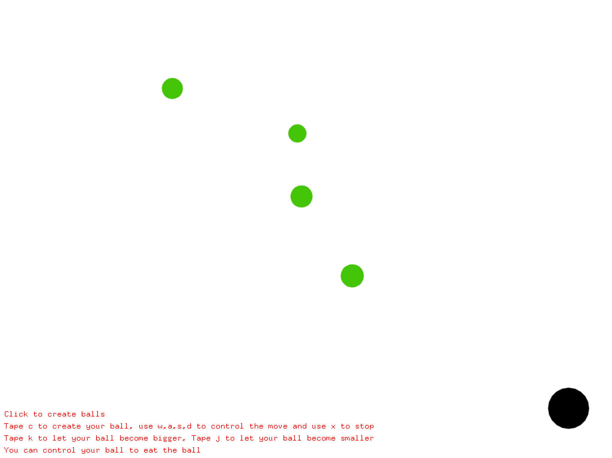
Inspiration
Attraction. Asteroids
Space War
Mover. The basic class of my program
Bouncing Ball. How to control the move of a ball

Slide 4
Implementation
Mover
glm::vec2 pos
glm::vec2 vel
glm::vec2 acc
float hp
float category

Slide 5
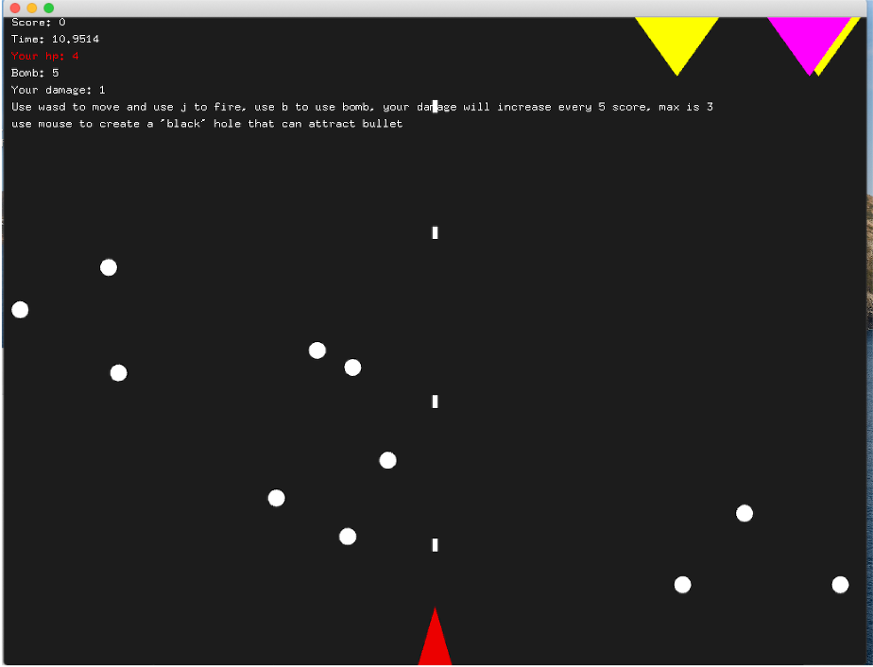
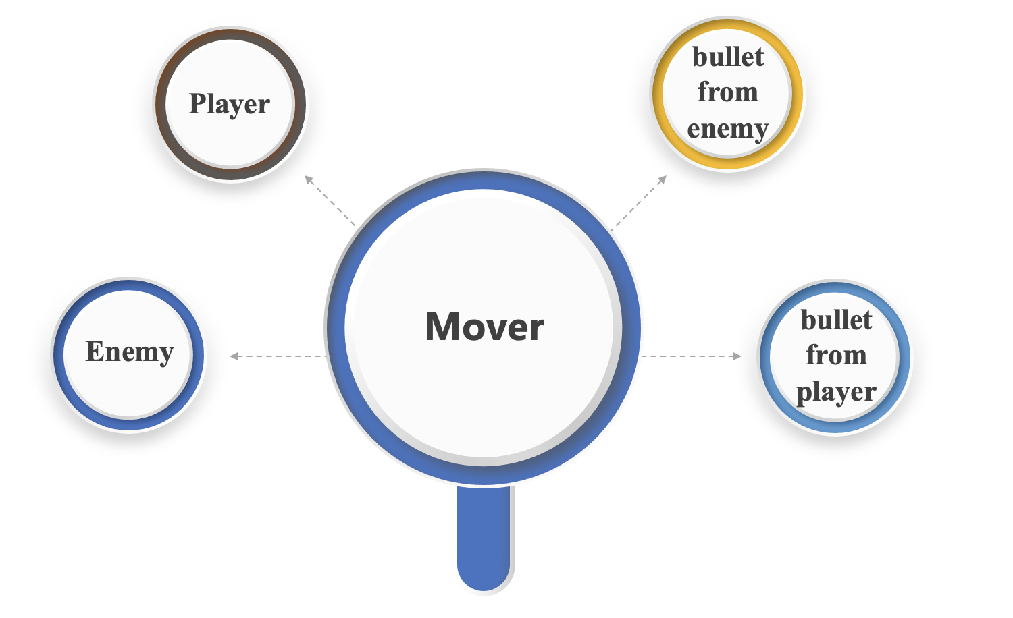
Implementation

Slide 6
Implementation
Use the Mover’s update() to update the position of the enemy, bullet and player.
Determine whether the position of the mover overlaps, if so, hp-1
update the position
Create the enemy and it will fire randomly
Determine if an enemy was hit by a bullet
Find a mover that hp is less than 1
The creator of the enemy is controlled by the timer, creating an enemy every 5 seconds and firing randomly
If hp <= 0, remove the Mover from the vector movers.

Slide 7
Interactive of player
The player can use j to create bullet mover
The player can press the mouse to create a black hole to attract bullet
Fire
Black hole
Move
Bomb
The player can use awsd to control the velocity of the spacecraft
The player can use b to create a different bullet mover called bomb

Slide 8


